Slide 1


The Ark & The ATR
Paul White

Slide 2
What is The Ark?
The Ark is an open-source software development project hosting and developing software to support Australian medical researchers
Based at the University of Western Australia with four full-time staff and collaborating staff at the Centre for MEGA Epidemiology and McGill University in Montreal.
Currently host software that supports about 20 research groups on dedicated hardware at the University of Western Australia
Founded in 2004
Originally funded by an NHMRC Enabling Grant
Transitioning from a proprietary software model to an open source Software as a Service model

Slide 3
So what is open-source software and what are the possible benefits?
Open source software (OSS) is for which the source code and certain other rights normally reserved for copyright holders are provided under a software license that permits users to study, change and improve the software.
Potential benefits include:
A larger developer and testing base leading to richer and more robust software
Ability for other institutions to host and support the software
Minimising the risk associated with having only one team that can develop and support the software

Slide 4
What is Software as a Service?
Software as a service is sometimes referred to as "software on demand":
  deployed over the internet
  licensed as a service on demand, through a subscription, in a "pay-as-you-go" model, or (increasingly) at no charge
  application delivery typically closer to a one-to-many model (single instance, multi-tenant architecture)
  centralized feature updating, which obviates the need for end-users to download patches and upgrades
* Externally hosted but not necessarily a shared instance

Slide 5
The Ark software will be used for managing the ATR and will be available to researchers
Twin
Membership
Mgmt
Twin Study
Participation
Invoicing &
Billing
Reporting
The
ATR
Phenotypic
Data Mgmt
Genotypic
Data Mgmt
Sample Processing & Mgmt
Data Extraction
Subject &
Consent
Management
Invoicing &
Billing
Subject
Assessment
Reporting
Researchers
Phenotypic
Data Mgmt
Genotypic
Data Mgmt
Sample Processing & Mgmt
Data Extraction

Slide 6







The Ark is currently managed from UWA but software may be installed anywhere
The Ark Developer(s) & Technical & Study Support
ATR Staff
Local
Network
Twin Researchers
Melbourne Server
Internet
Local
Network
Perth Server
Twin Researchers
The Ark Developer(s) & Technical & Study Support

Slide 7
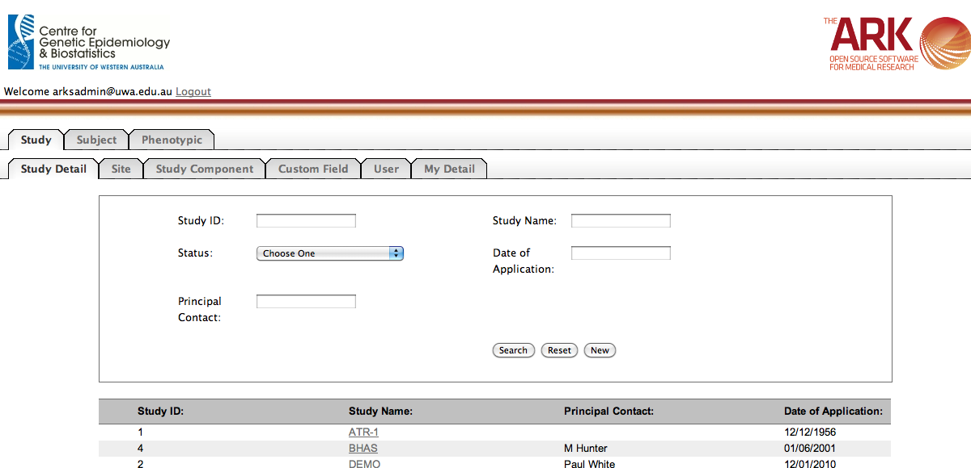
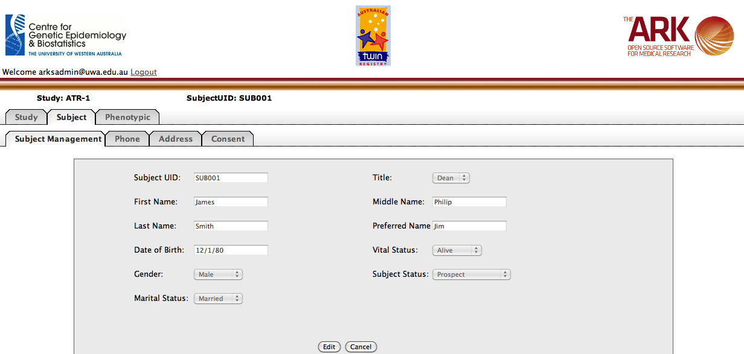
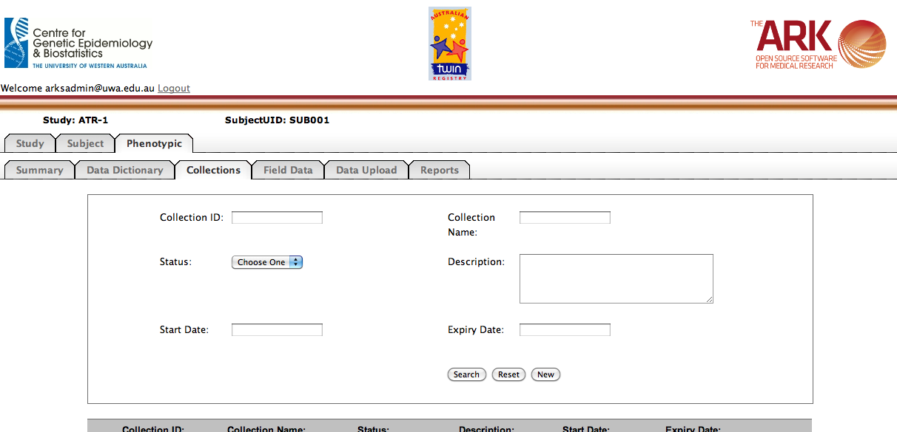
The first release is scheduled for March

Slide 8
Functionality will then be released in stages throughout the year
Correspondence Management
Reporting
Data Extraction
Registry Management
Collaborator Management
Contact Management
Mar 2011
Apr 2011
May 2011
Jun 2011
Jul 2011
Aug 2011
Mar 2010
Sep 2011
Study Management
Subject Management
Phenotypic Data Management
Laboratory Information Management System (LIMS)
GWAS Data
Management

Slide 9
There are a number of tenets that we follow
The software should be modular, with researchers only needing to install/enable the modules required
The software should be highly configurable – study setup should be achievable through configuration, rather than customisation
One instance of the software should be able to run multiple studies
The software should cater to the requirements of a broad user base rather than the specific needs of any one registry or study

Slide 10
The technology stack
Tools
  Confluence Wiki for documentation and design
  Jira for issue tracking and project management
  Balsamiq for web site mockups
  Hudson for continuous integration
  Subversion source code control
Java
  Wicket development framework
  Hibernate database abstraction
  jQuery user interface components
Databases
  MySQL and Oracle to start with

Slide 11
What does this mean for ATR researchers?
Researchers will be able to take advantage of data collected by prior researchers and provided back to the ATR
Researchers will have access to a cost-effective set of informatics tools designed to support study conduct
Data quality can be improved through the implementation of integrated online data collection tools, integrated QC functionality and maintenance of a single master record for all research data
Data is more secure from both prevention of loss as well as privacy perspectives
Collaboration between researchers is improved as geographically dispersed researchers can work on the same data sets at the same time
Researchers will have access to tools to store and manipulate large amounts of data
Preparation time of data for analysis will be reduced
Reporting and ethics requirements will be easier to satisfy

Slide 12
Adopting a Software as a Service deployment model has additional benefits for researchers
  Save money by not having to purchase servers or other software to support use
  Faster Implementation - deploy SaaS services/products within hours rather than weeks or months.
  Economies of scale
  Flexibility and scalability
  Reliability

